Slide 1
Jumping Ball A 2D platformer puzzle game
Team: Jumping Gamers

Slide 2
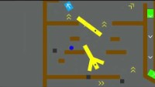

Slide 3
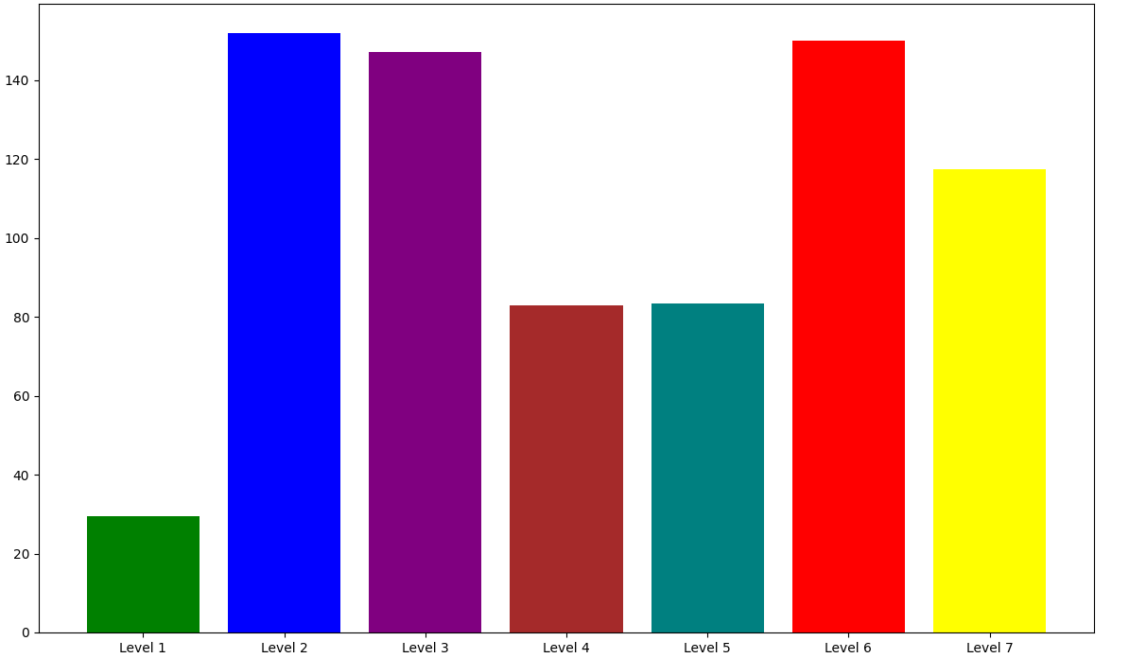
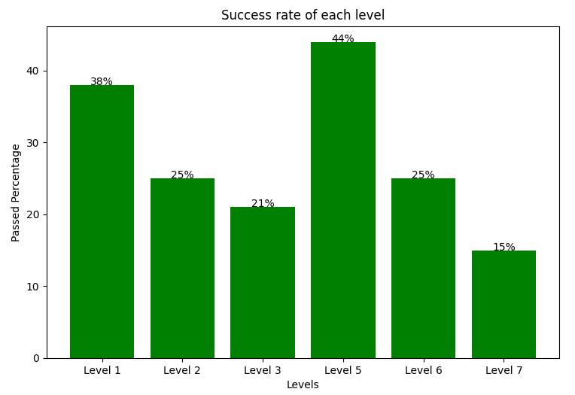
Average Time Used
2 mins
Average Time (sec)
1 mins
Level

Slide 4
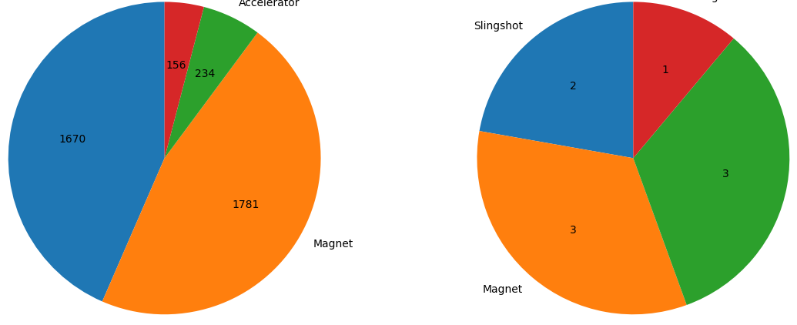
Tool Usage
Level 2
Tool Usage
Tool Existence
Railgun
Railgun
Accelerator
Slingshot
Slingshot
Accelerator
Magnet
Magnet

Slide 5
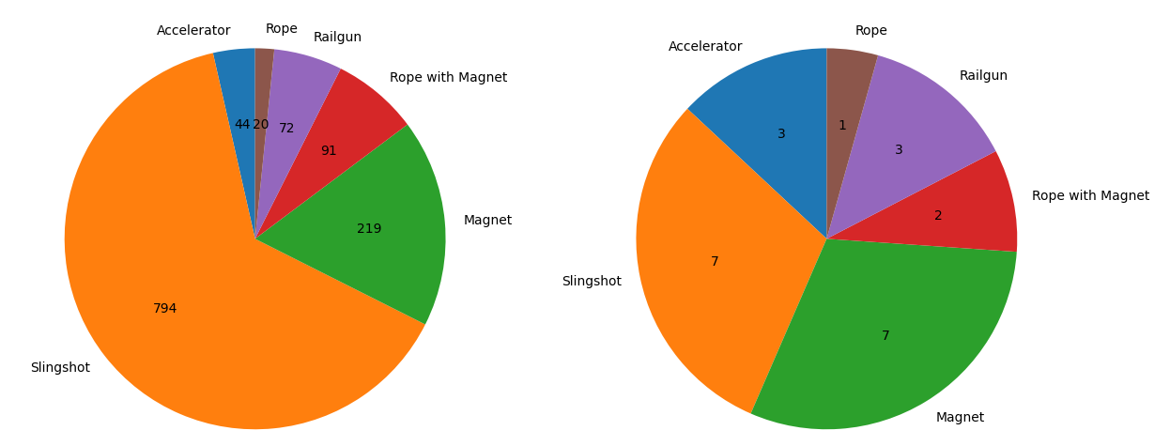
Tool Usage
Level 6
Tool Usage
Tool Existence
Slingshot
Slingshot

Slide 6
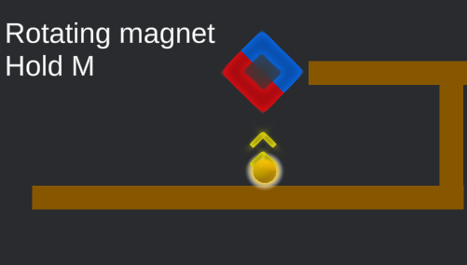
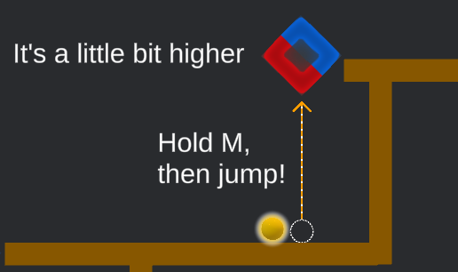
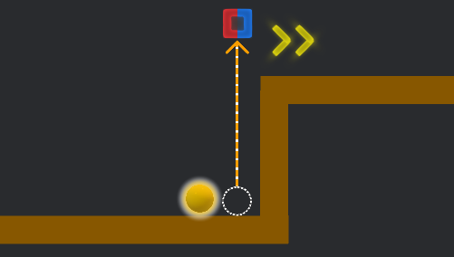
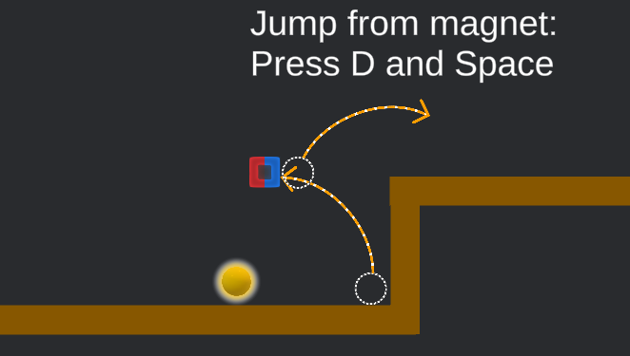
Improvement: Tutorial
…

Slide 7
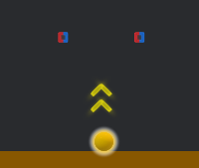
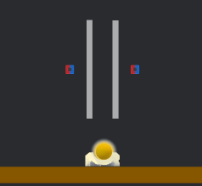
Improvement: Slingshot
Before
After

Slide 8
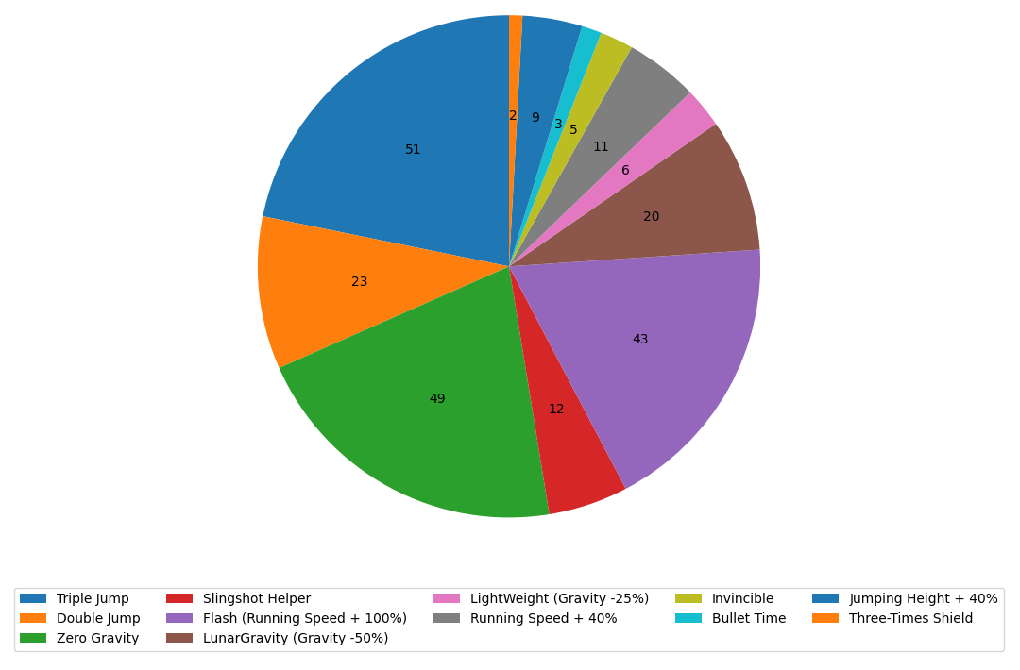

Card Usage
$$≈\frac{1}{5}$$
Card usage per attempts
Total usage of cards: 234
Total attempts: 1047

Slide 9
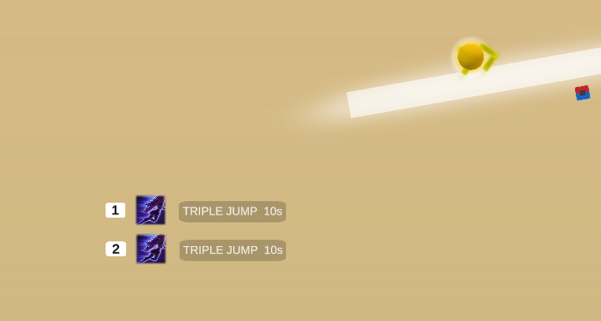
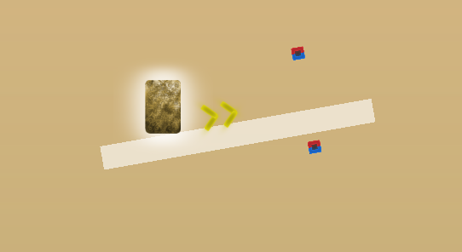
Card Usage
Re-design UI
You can have 2 Cards
Collectible card

Slide 10
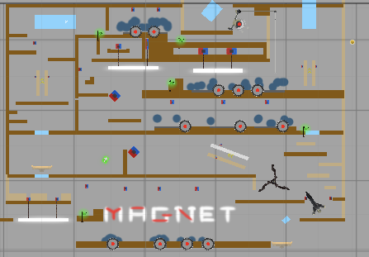
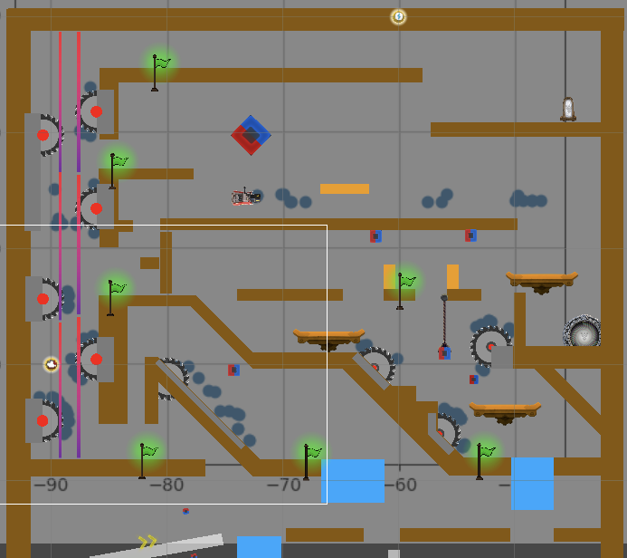
Card Usage
Level 5
Level 7

Slide 11
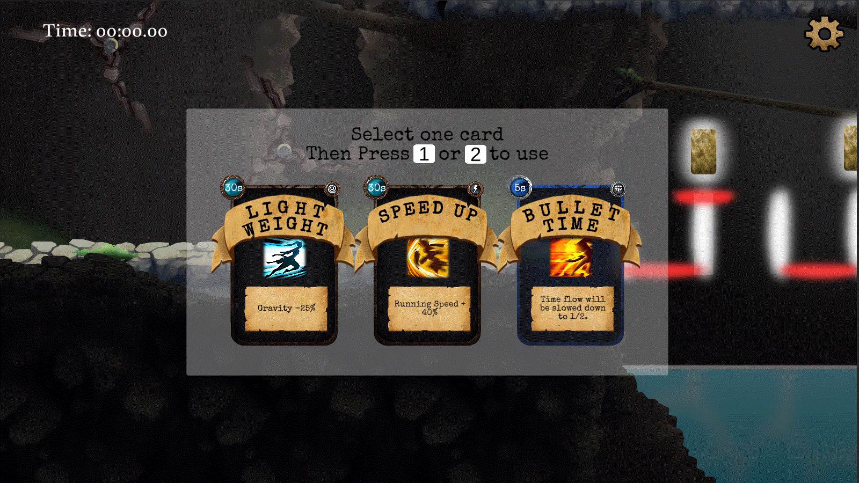
Rebinding Key System

Slide 12
Card System

Slide 13
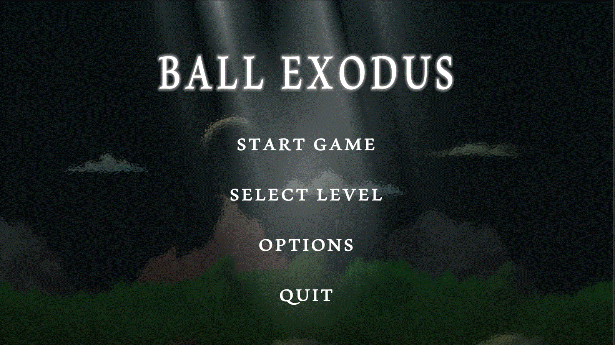
Level Selection

Slide 14


Slide 15
